Slide 1

Course Id :INT 213

Slide 2
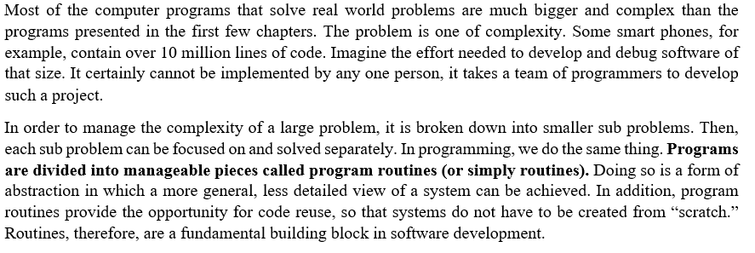
PROGRAM ROUTINES

Slide 3
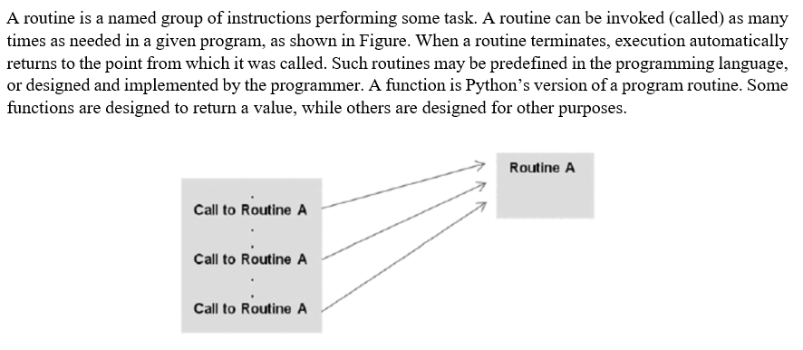
FUNCTION ROUTINE

Slide 4
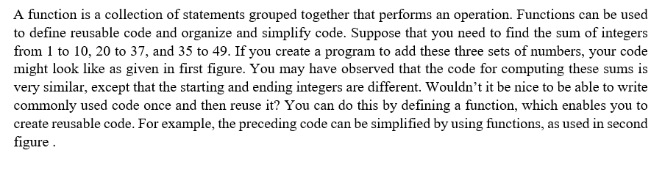
FUNCTIONS

Slide 5
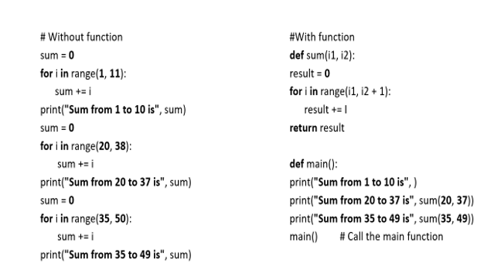
FUNCTIONS

Slide 6
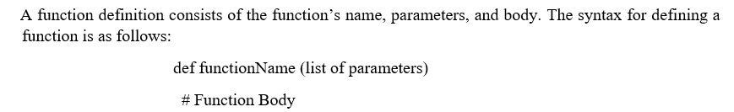
DEFINING A FUNCTION

Slide 7
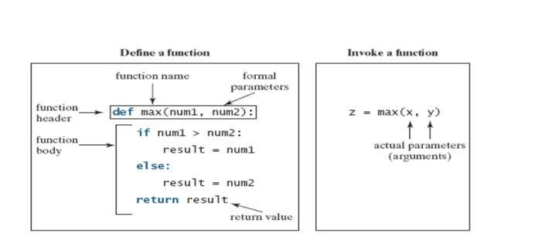
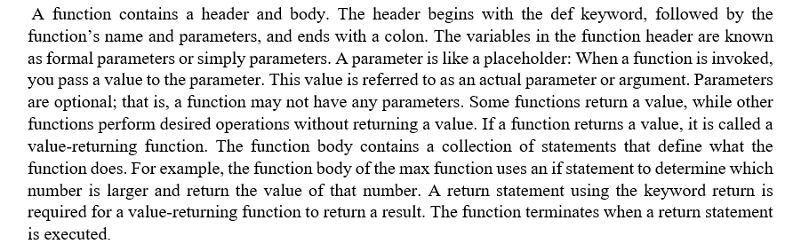
Let’s look at a function created to find which of two numbers is bigger. This function, named max, has two parameters, num1 and num2, the larger of which is returned by the function. Figure illustrates the components of this function.

Slide 8
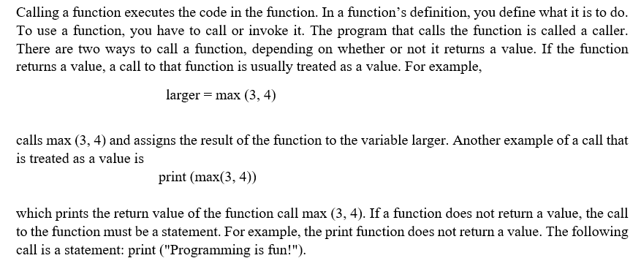
CALLING A FUNCTION

Slide 9
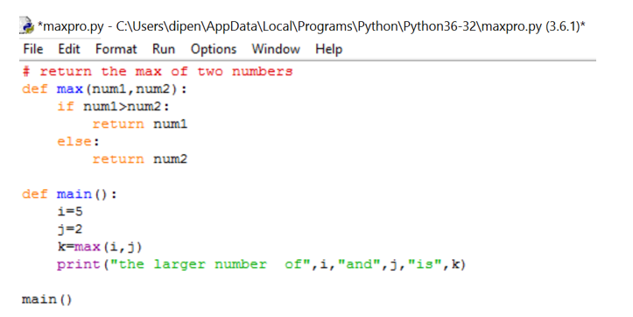
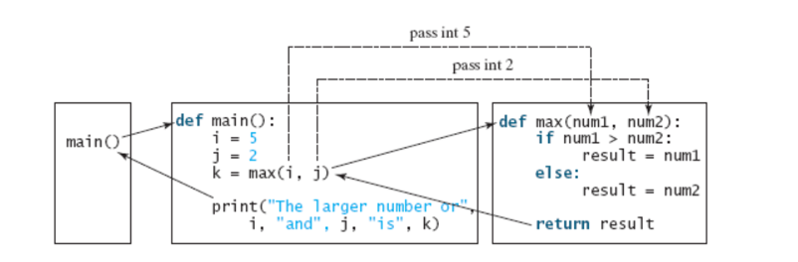
FUNCTION CALL

Slide 10
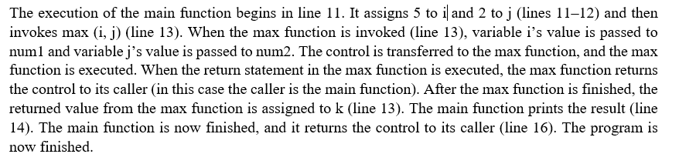
FUNCTION CALL

Slide 11
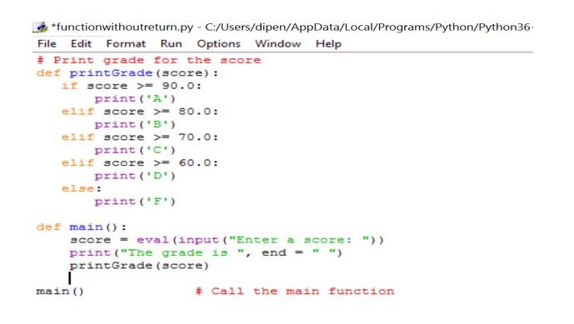
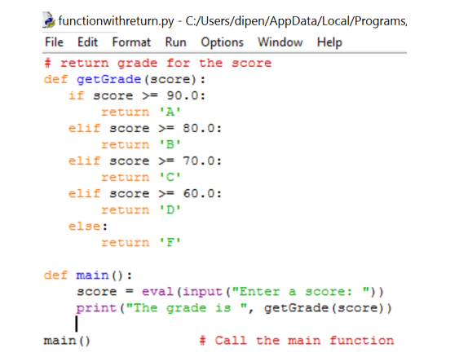
TYPES OF FUNCTIONS
Non value returning function
Value returning function

Slide 12
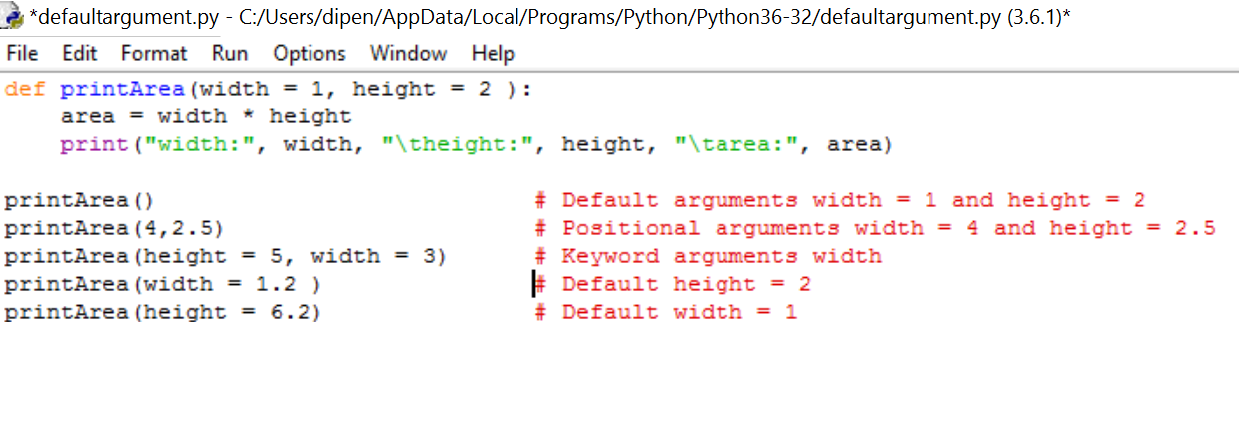
DIFFERENT TYPES OF ARGUMENTS

Slide 13
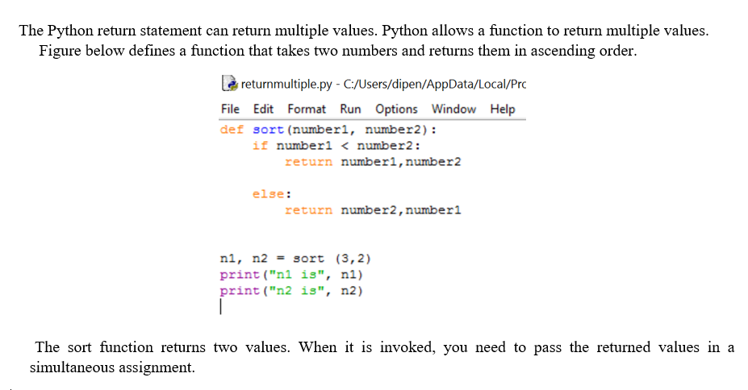
RETURN OF MULTIPLE VALUES

